Slide 1

Ch Sowmya Vaishnavi-PES2UG24CS126
Nikhil Gadina-PES2UG24CS165
Deeksha Prasad-PES2UG24CS176

Slide 2


Slide 3
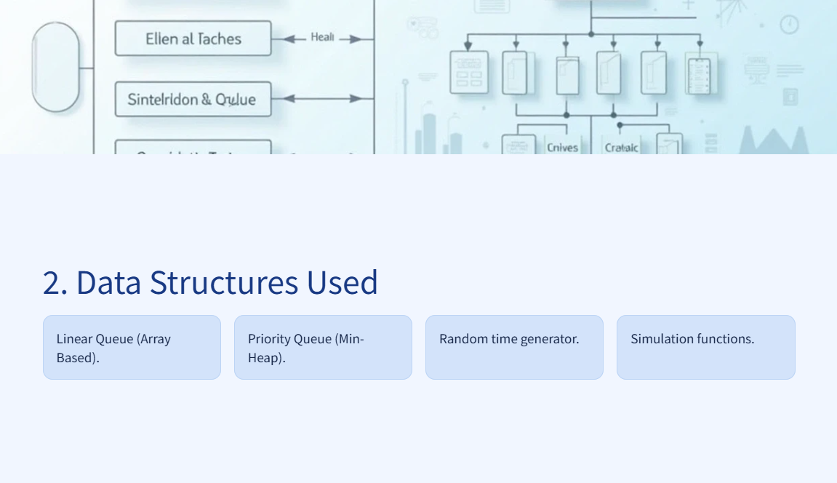

Slide 4
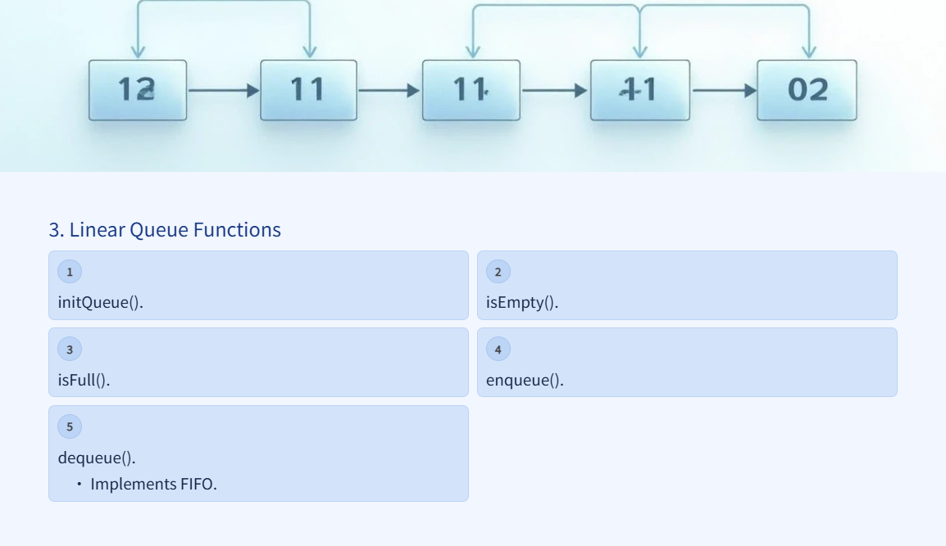

Slide 5
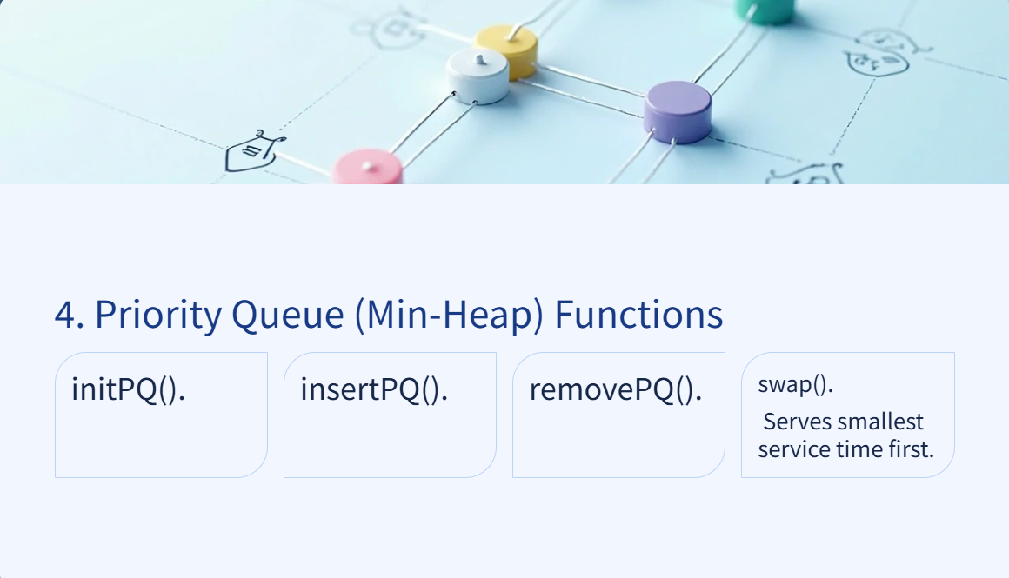

Slide 6
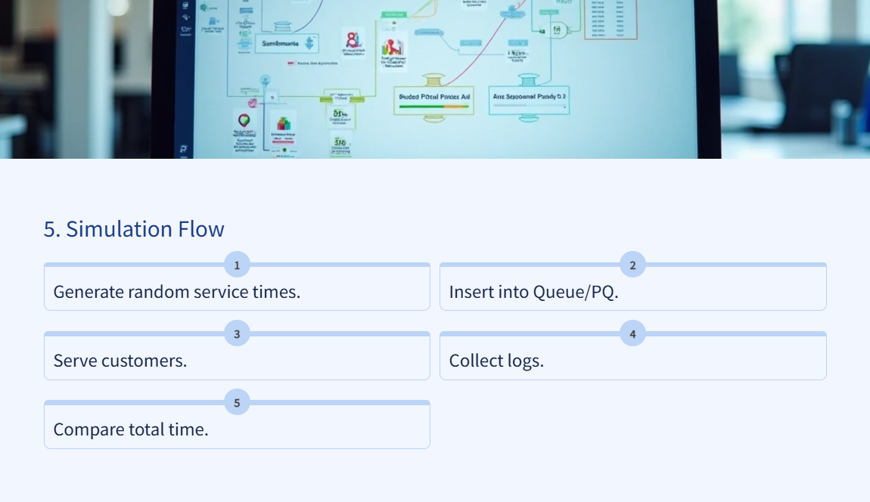

Slide 7


